Slide 1
SCIENTIFIC FOUNDATIONS OF HEALTH
21SFH19- MODULE-4
Avoiding risks and harmful habits:
Characteristics of health compromising behaviors
Recognizing and avoiding of addictions
how addiction develops and addictive behaviors
Types of addictions
Differences between addictive people and non addictive people
Effects and health hazards from addictions

Slide 2
Characteristics of health compromising behaviors
The six health-compromising behaviors
(low fruit
consumption, high sweet consumption, less frequent tooth brushing, low physical activity, physical fighting and smoking) clustered into two clusters.
The first cluster included low fruit consumption, less frequent tooth brushing and low physical activity.
The second cluster included high sweets consumption, smoking and physical fighting.

Slide 3
Recognizing and avoiding of addictions
Recognizing an addiction problem in someone you know can be harder than it seems.
The American Society of Addiction Medicine (ASAM) defines addiction as a chronic disease that affects the brain’s reward, motivation, and memory functions. Someone with an addiction will crave a substance or other behavioral habits. They’ll often ignore other areas of life to fulfill or support their desires.

Slide 4
General signs of addiction are
Lack of control, or inability to stay away from a substance or behavior
Decreased socialization, like abandoning commitments or ignoring relationships
Ignoring risk factors, like sharing needles despite potential consequences
Physical effects, like withdrawal symptoms or needing higher dosage for effect

Slide 5
Substance addiction is dependence on any one or more of the following:
nicotine, or tobacco
alcohol
inhalants, often household items like oven cleaners, spray paints, or other aerosol products
drugs, illicit or non-illicit
medication

Slide 6
Behavioral addiction can include:
gambling
working
shopping
video games
using the Internet or media

Slide 7
Signs that point towards changes in their health can include:
bloodshot or glazed eyes
constant illness
unexplained injuries
abrupt change in weight
bad skin, hair, teeth, and nails (especially when substance abuse involves illicit drugs like methamphetamines or cocaine)
increased tolerance to drugs
physical withdrawal symptoms like sweating, trembling, or vomiting
memory loss or problems with recall
change in speech like slurred words or rapid rambling

Slide 8
The following mental and emotional changes could also be signs of an addiction problem:
sudden changes in mood
aggressive behavior
irritability
depression
apathy
suicidal thoughts

Slide 9
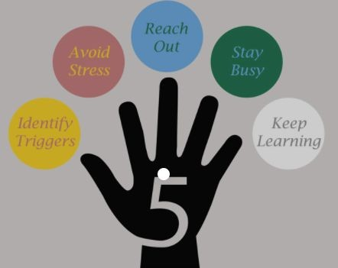

Slide 10
Types of addictions
Today, most experts recognize two types of addiction:
Chemical addiction. This refers to addiction that involves the use of substances.
Behavioral addiction. This refers to addiction that involves compulsive behaviors. These are persistent, repeated behaviors that you carry out even if they don’t offer any real benefit.

Slide 11
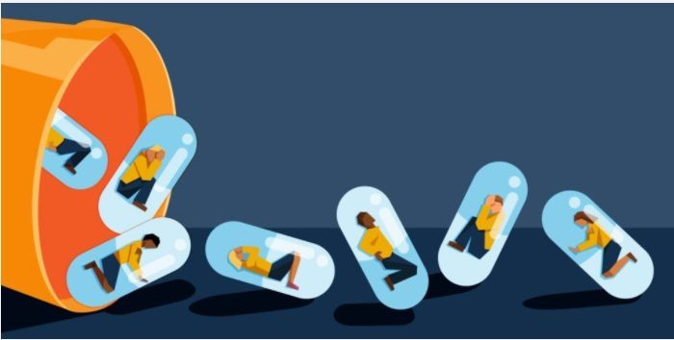

Slide 12
we’ll explore some of the serious health conditions that may be caused or worsened by substance abuse, including:
Diminished immune system function and infection.
Cardiovascular problems.
Gastrointestinal issues.
Respiratory problems.
Liver damage.
Kidney damage.
Neurological issues.

